Slide 1
Key Stage 2 Parent Workshop 2024-5

Slide 2
A Journey of Discovery
Be Kind. Be Ready. Be Curious.

Slide 3
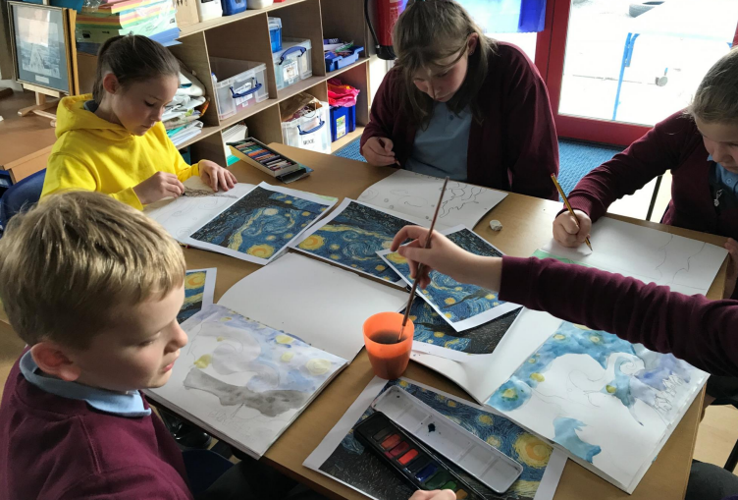
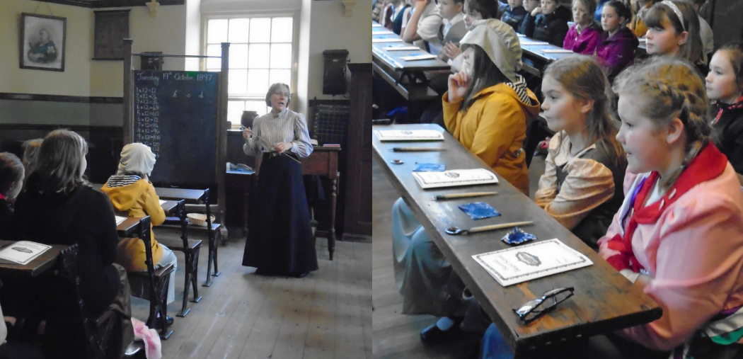
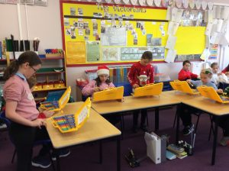
A Creative Curriculum
Our vision and ethos at Errington Primary School is based upon equality of opportunity. We believe that all children should be given every opportunity to thrive in all aspects of their school life and beyond. We provide experiences that are diverse and relevant for 21st century learners.
We think creatively with pupil voice at the core of what we do, listening to children’s interests so that learning is relevant and built upon pupil's previous learning. Our curriculum is central to all we do, planning real hands-on experiences that brings learning alive and inspires curiosity.

Slide 4
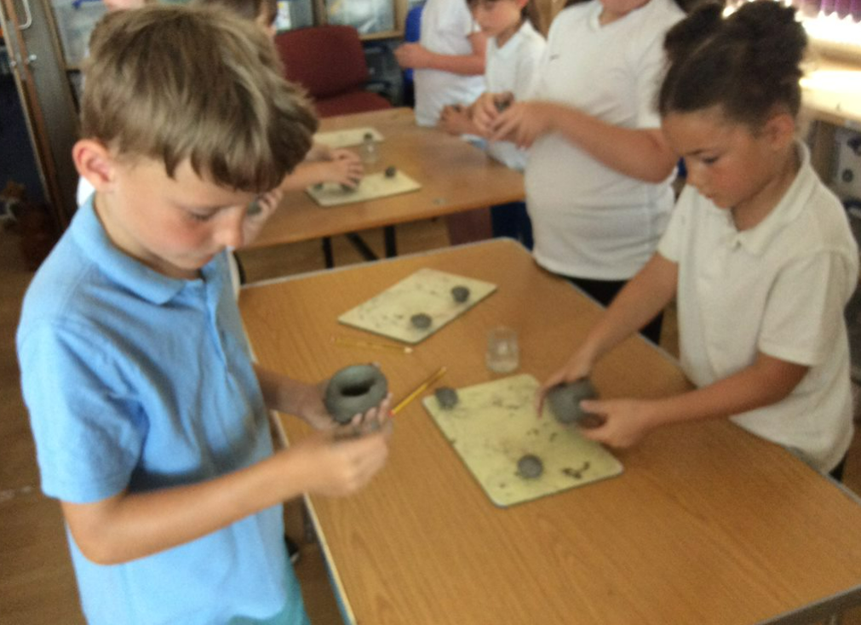
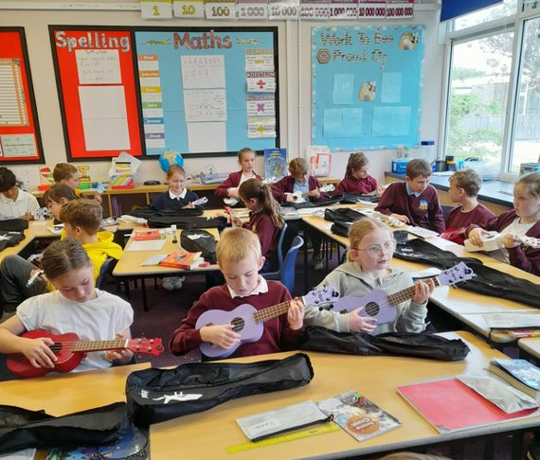
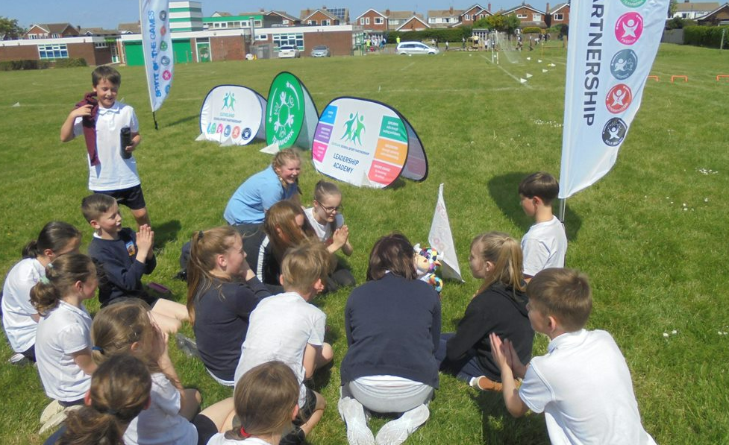
Topic-based approach/ The Wider Curriculum
We aim to teach the majority of our curriculum through topics where possible. Each subject is planned in order to deliver a progressive approach with linear threads which allow skills and knowledge to develop as children move through school. We aim to provide children with a variety of rich experiences through visits, visitors, investigations and a creative approach to embed learning and develop curious and enquiring young people.
Each year group has the opportunity to learn a musical instrument, take part in sports festivals, participate in swimming lessons, learn French and much more!
Notes:
For example, some of our linear threads in history are oppression, conflict, local history links but will be adapted for the topic with reference to prior learning.

Slide 5
A Love of Reading
At Errington we wish to instill in the children a passion for reading by providing them with access to quality classic and contemporary texts covering a range of genres. Reading should be at the heart of the whole curriculum and every opportunity to use quality books as a stimulating starting point and throughout the learning process will be explored.
Children are expected to read at home each night. This can be a mixture of Accelerated Reading books from school, books from home, comics, magazines, encyclopaedias etc. Please records this in your reading record to collect golden tickets.

Slide 6
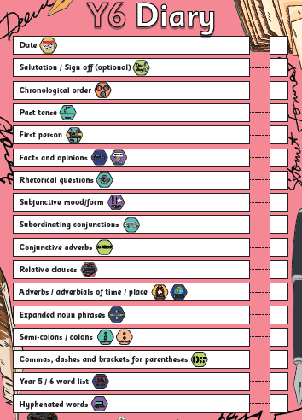
A Grammasaurus Approach to Writing
This is a progressive approach which incorporates the grammar which is appropriate to text types that children are required to write.
Each genre will take between 2-3 weeks and will start off with children doing a ‘cold write’ . Teachers then prioritise elements of writing that need to be revised, introduced or modelled.
Each unit comes with a checklist of specific language features, organisation, grammar elements and punctuation.
Children will discuss purpose and audience and appropriate language features.
Ideas will be modelled either verbally or written and this will feed into a final piece of writing. Each year builds on previous knowledge.

Slide 7
Maths
Concrete, Pictorial and Abstract (CPA) approach
We recognise that the CPA approach is highly effective in the teaching of Maths.
This is a mastery approach to teaching mathematics. True mastery aims to develop all children’s understanding at the same pace.
As much as possible, children should access the same learning. Differentiation should primarily be through support, scaffolding and deepening, not through task or learning outcome.
Objects, pictures, words, numbers and symbols are everywhere. The mastery approach incorporates all of these to help children explore and demonstrate mathematical ideas, enrich their learning experience and deepen understanding.

Slide 8
Learning at Home
Errington Website
Homework is given out on a Friday and marked on a Wednesday. Children are tested on their spellings on a Friday. There is an optional 'fun' homework grid of activities children can complete at home and share with their class.

Slide 9
Mental Health
At Errington, we pride ourselves on developing the whole child; a big part of which is focussing on the emotional wellbeing and mental health of each of our pupils.
We have a fantastic array of support on offer to all children here at Errington. We are great believers in accessing early intervention at the first signs of need, as this can prevent smaller issues progressing and becoming more problematic, whilst developing safe and healthy ways to manage emotional wellbeing.
The Yellow Room
Post box system
The Whole Child curriculum
PSHE / circle time
Themed assemblies
Head starters
Worry boxes in classrooms
Wellbeing workshop (drop in sessions)
Groups and individual sessions with practitioners (various agencies)
Hello Yellow charity day (10th Oct)

Slide 10
Mental Health
Wellbeing toolkits and zones of regulation….

Slide 11
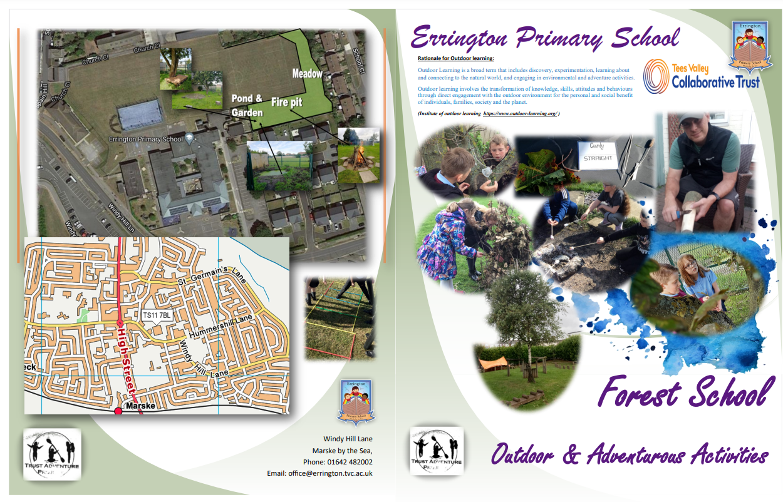
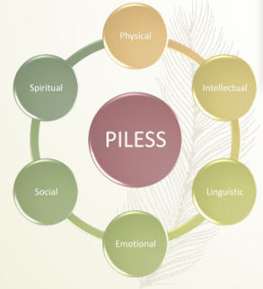
Outdoor Learning
- Each cohort will have 12 hours of 'Forest School'
- T.A.P - Trust Adventure Project

Slide 12
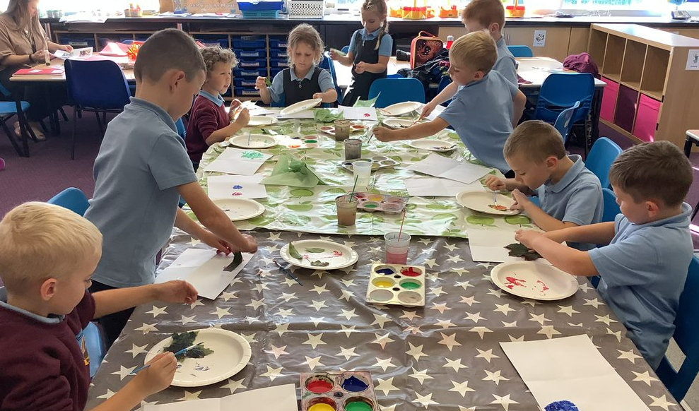
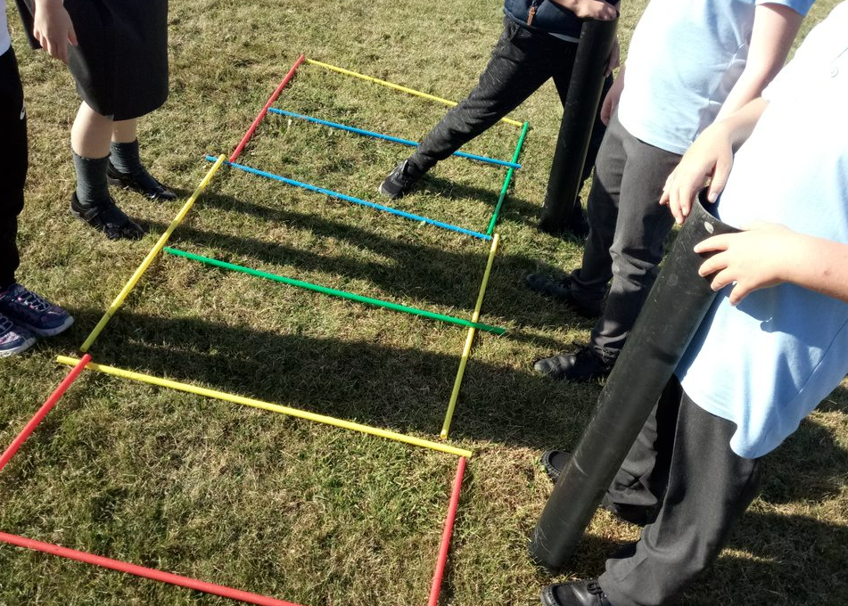
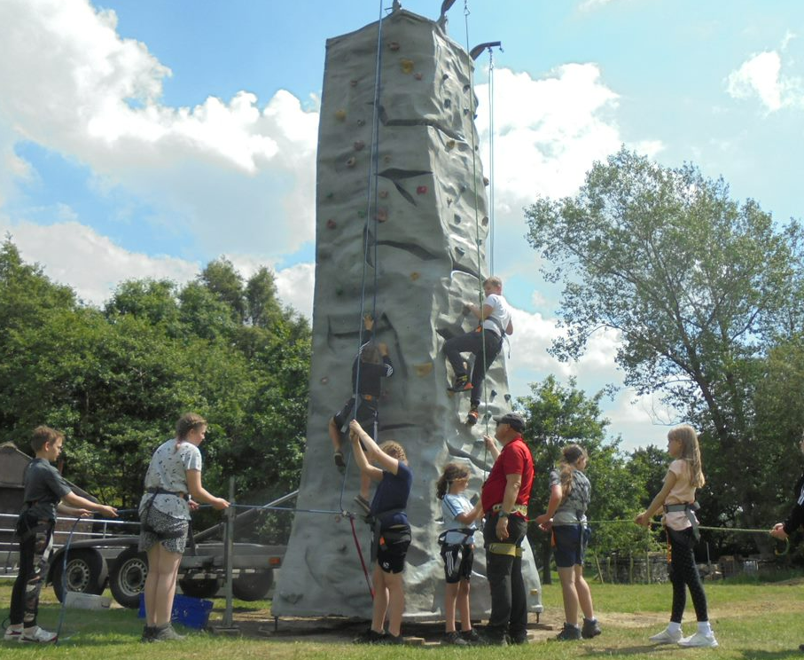
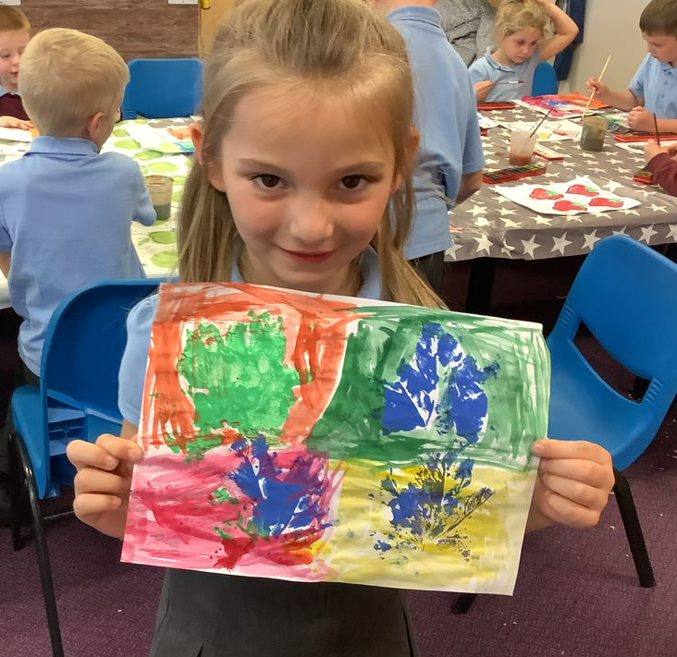
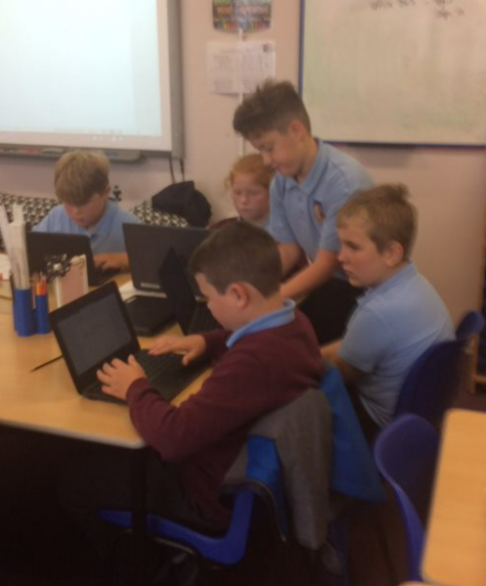
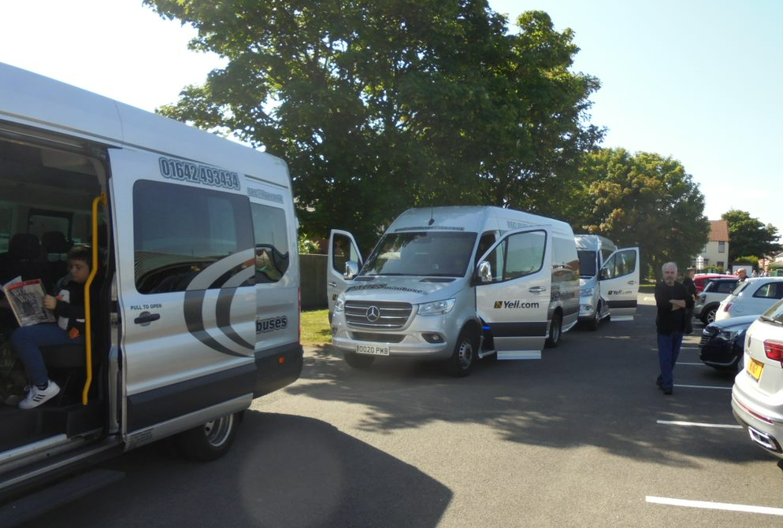
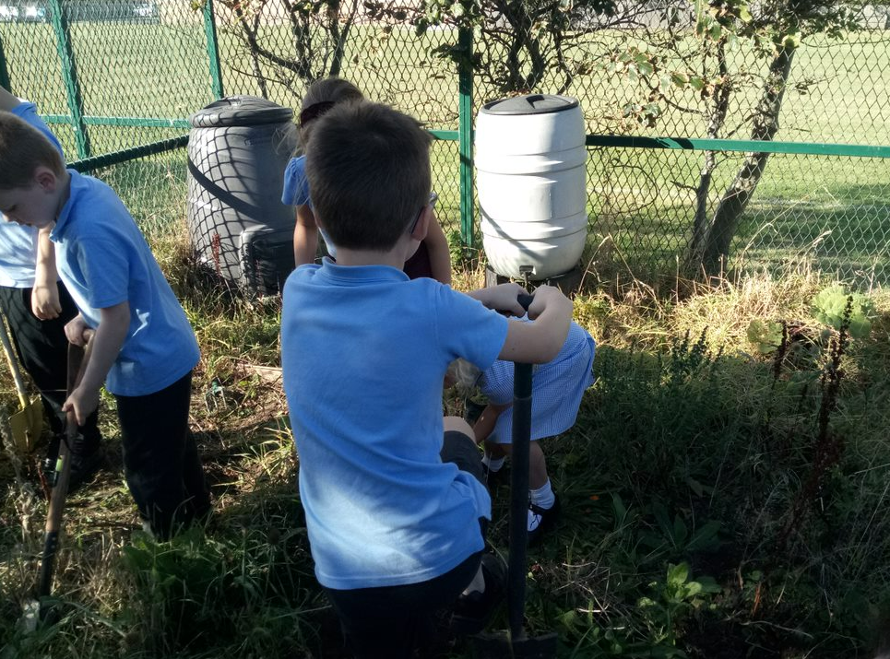
Enriched Curriculum

